Slide 1




2021 Datathon Case
Expansion into the Nebraska Mortgage Market
Jiaqi Bi, Eric Lee, Jiaqi Li, Ruichen Lu, Scarlett Wang, Jiner Zheng
October 11, 2021

Slide 2
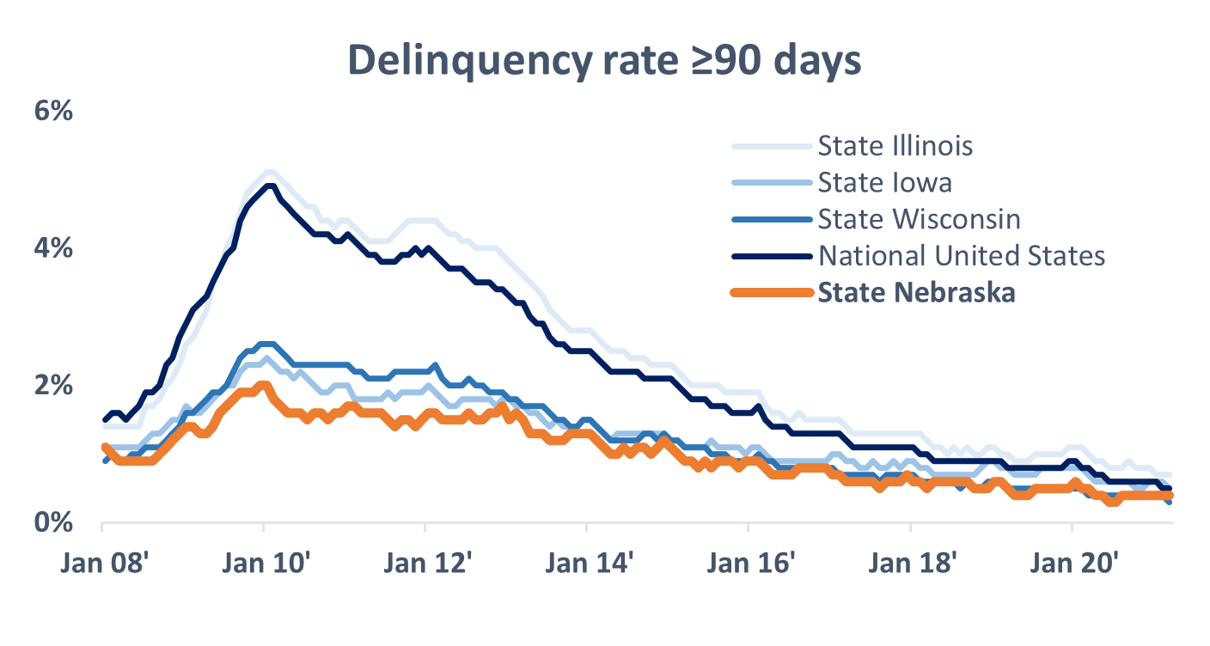
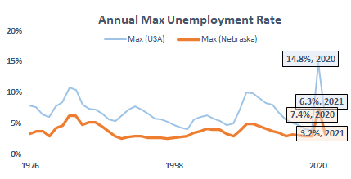

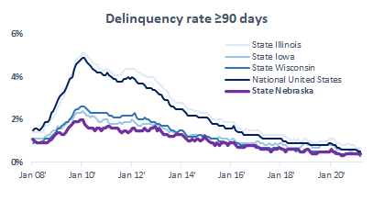
Introduction
2008
2021
2022 and Beyond
Brief History
Current Situation
Future
Great Lakes Midwest Bank
Nebraska Expansion
?
Figure 1) Historical % of 90+ day delinquent mortgages
Figure 2) Maximum unemployment rate by year - USA and Nebraska
Brief History
Current Situation
Future
After recovering from the 07’ - 08’ global financial crisis largely started by the subprime mortgage crisis, a lesson was learned on the importance of credit risk and management, with new regulations passed (e.g. the Dodd-Frank Act) to prevent such an event from happening again
Since then, 90+ day delinquencies have been on a consistent downtrend despite the impact of COVID-19
Nebraska has historically had a lower delinquency rate versus states that Great Lakes Midwest Bank currently operates in and the majority of other states
COVID-19 is still disrupting many lives globally after causing an increase in the loss of life, record high unemployment in over 70 years reaching 14.8% in Apr 2020, and sustained supply chain disruptions still causing serious issues today
Despite the fact, the unemployment rate has recovered to a 2021 year-to-date max of 6.3% as of Sept 2020 with percentage of longer delinquencies
Nebraska has fared well versus the annual unemployment rate, reaching instead a max of 7.4% in 2020, with a 2021 year-to-date max of 2.2%, versus the annual average of 14.8% and 6.3% respectively
As Great Lakes Midwest Bank looks to expand mortgage operations to Nebraska, we sought to propose the best pathway forward
While we can never be certain of the future, our analysis will look at historical mortgage data to properly segment our proposed targets, and include an analysis on possible future scenarios
Notes:
Figure A) Line chart prepared using data from: https://www.consumerfinance.gov/data-research/mortgage-performance-trends/download-the-data/
Figure B) Line chart prepared using data from: https://fred.stlouisfed.org/series/UNRATE and https://fred.stlouisfed.org/series/NEUR
Nebraska Unemployment Data from: https://data.bls.gov/timeseries/LASST310000000000003?amp%253bdata_tool=XGtable&output_view=data&include_graphs=true

Slide 3








Analytics Flow
Data
Business Question
We conducted analysis on dataset of all conventional single-family, fixed interest rate mortgages from 2000-2021 Q1 in the state of Illinois, Iowa and Wisconsin. We classified those loan types with “Delinquent, Reperforming Loan Sale, REO Disposition, Repurchased, Short Sale, Notes Sales” as the defaulting loan while the rest to be favorable loan for further data analysis.
How to maximize dollar value of mortgages (maximize the mortgage amount) and limit the defaulting loan with the consideration of other concerns in the market.
Statistical Model
Business Outcome
A logistics regression model with mixed effects models was used to perform analysis. We set whether the loan is defaulting as the binary response variable, and Metropolitan Statistical Area as the random effect. Also, we classified factors as primary
factors and secondary factors.
We carried out an actionable plan for Great Lake Midwest Bank to do the mortgage expansion on state of Nebraska.

Slide 4
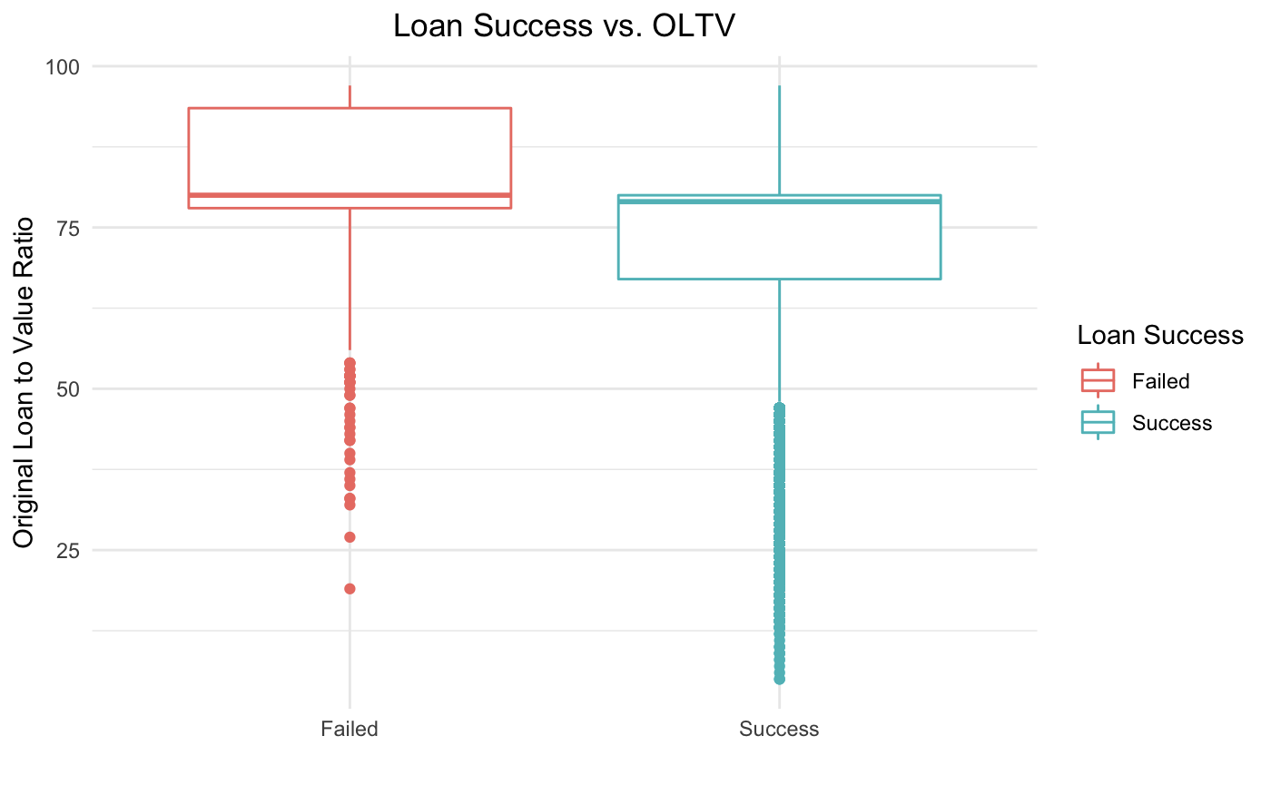
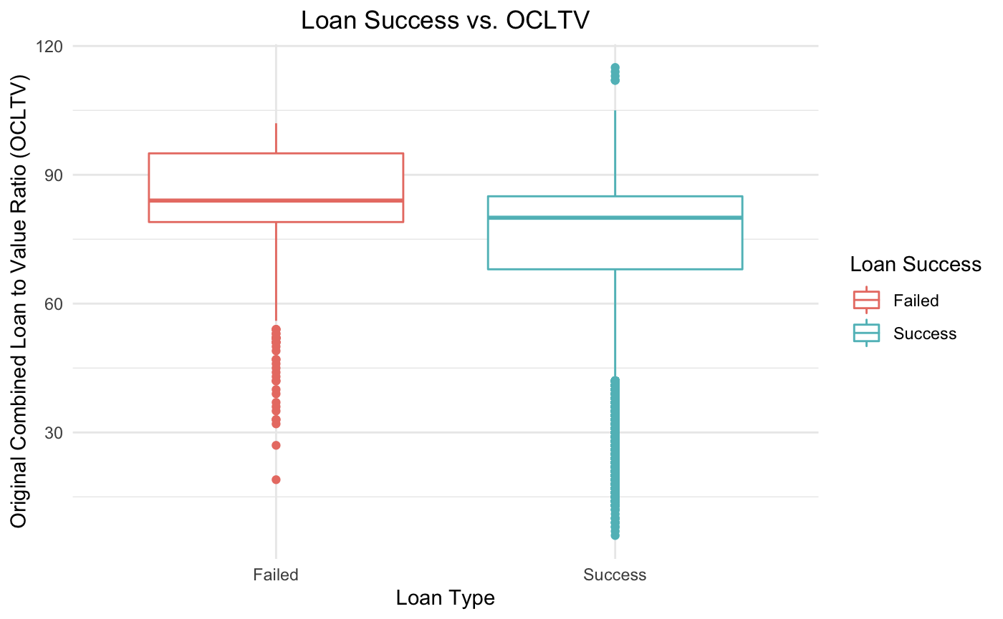
Loan Success
Original Loan-to-Value and Original Combined Loan-to-Value Ratio ( Primary Factors)
Findings
OLTV and OCLTV are primary factors that could affect the loan success rate. Statistically speaking, for each percentage increase in OLTV, the odds of being a successful loan decreases by 1.0481. In layman terms, there is a very high correlation.
The average OCLTV for failure loan is around 84%, versus successful group, around 80%.
The average OLTV for failure is around 80%, higher than the average OLTV for success that is around 79%. While the third quantile for failure is around 95% which gives a significance that higher the OLTV is, higher the failure rate is.
Recommendation
OLTV and OCLTV are both important factors that can affect the success rate for mortgage. We recommend Great Lakes Midwest Bank to select borrowers with both low OLTV and OCLTV to limit the defaulting loans.

Slide 5
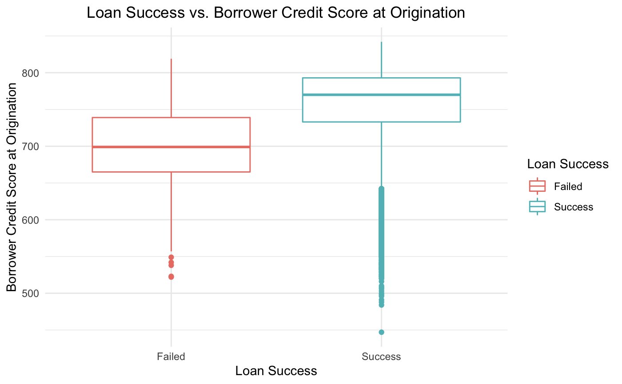
Loan Success
Borrower Credit Score (Primary Factor)
Findings
1
2
Credit score can reflect a borrower’s sense of responsibility and ability of paying back mortgages, and thus this is another strong factor for the financial risk.
Unsuccessful borrowers’ credit scores are mostly below 730, with a median less than 700.
On the contrary, successful borrowers have higher credit scores where the median lies around 780.
1
2
Recommendation
The bank should focus on those districts where the average of borrower’s credit score is relatively high (>750), in order to minimize risk for mortgages

Slide 6
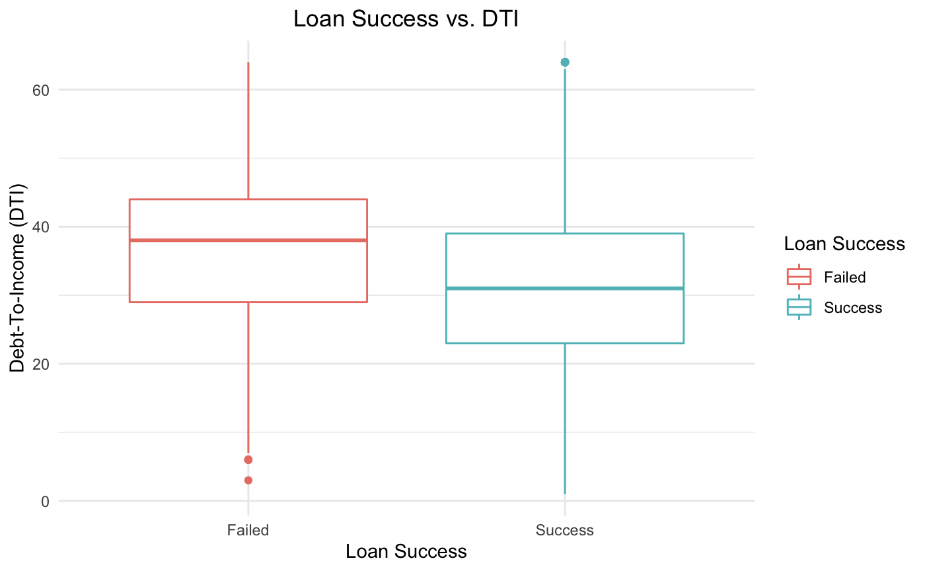
Loan Success
Debt-to-income (Primary Factor)
Findings
The DTI ratio has a correlation with the loan success rate:
Higher DTI may lead to a higher possibility of loan failure
The graph shows that the successful loan has a median of around 36% of DTI, and the trend for DTI is approximately 5% lower than the failed loan
We consider that a lower DTI gives the borrower more sufficient funds for his loan, and therefore the determination of mortgage repay ability is much easier than the higher DTIs.
Recommendation
DTI is a strong factor for the determination of a borrower’s financial risk.
The bank’s target segments should include a criteria for DTI

Slide 7
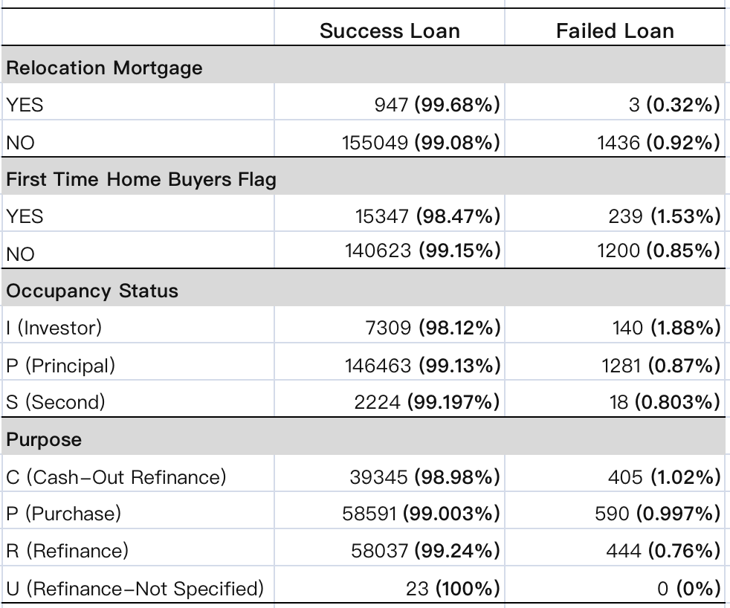
Loan Success
Loan Success by Four Secondary Factors
1
Findings
The presented table includes the probability of loan success based on four secondary factors including relocation mortgage, first time home buyers flag, occupancy status, and loan purpose.
The proportion of success loan in relocation mortgage is slightly higher compared to that in non-relocation mortgage.
The proportion of success loan in a NON-first time home buyer mortgage is slightly higher.
Second occupancy status has slightly higher proportion of success loan compared to the other two occupancy status.
Refinance mortgages have a slightly higher proportion of success loan compared to the other three loan purposes.
2
1
3
2
3
4
4

Slide 8
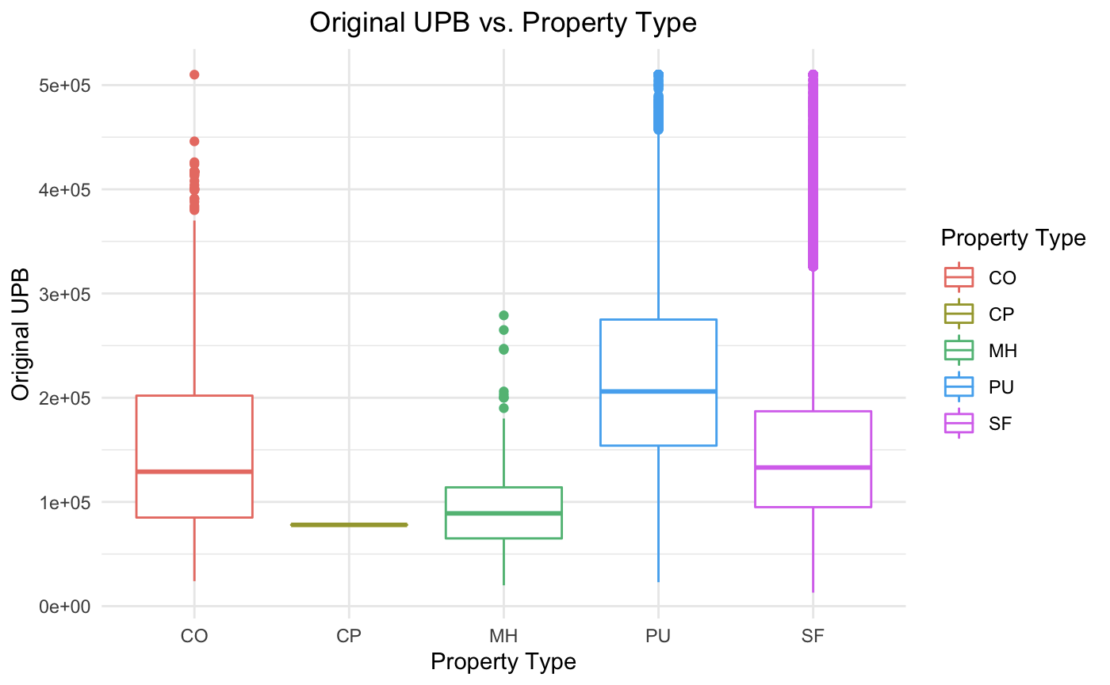
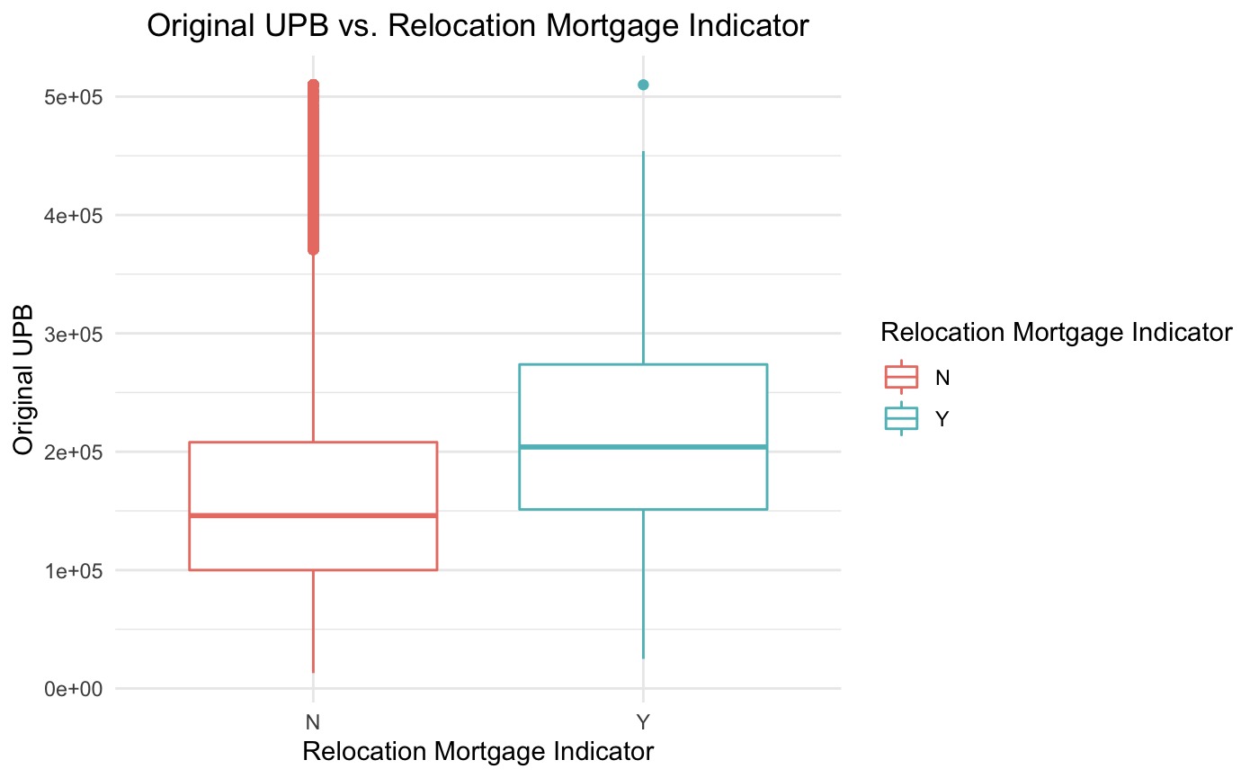
Mortgage Amount
Original Unpaid Balance (UPB) by Property Type and Relocation Mortgage (Secondary Factors)
$0.5m
$0.4m
$0.3m
$0.2m
$0.1m
0
$0.5m
$0.4m
$0.3m
$0.2m
$0.1m
0
Condo
Coop
Manufactured
Home
Planned Urban
Development
Single Family Home
Findings
Property Type
The property type of planned urban development appears to have highest median of original UPB compared to all other types. Co-operative and manufactured home property types have relatively lower median of original UPB.
Relocation Mortgage Indicator
Relocation mortgage loan appears to have comparatively higher median of the dollar amount of loan.

Slide 9
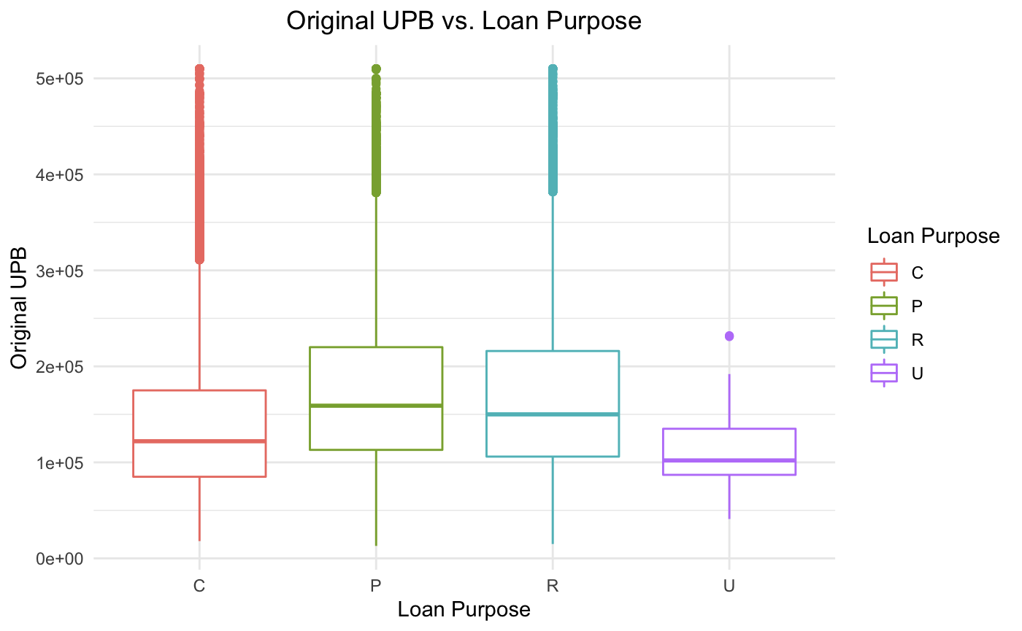
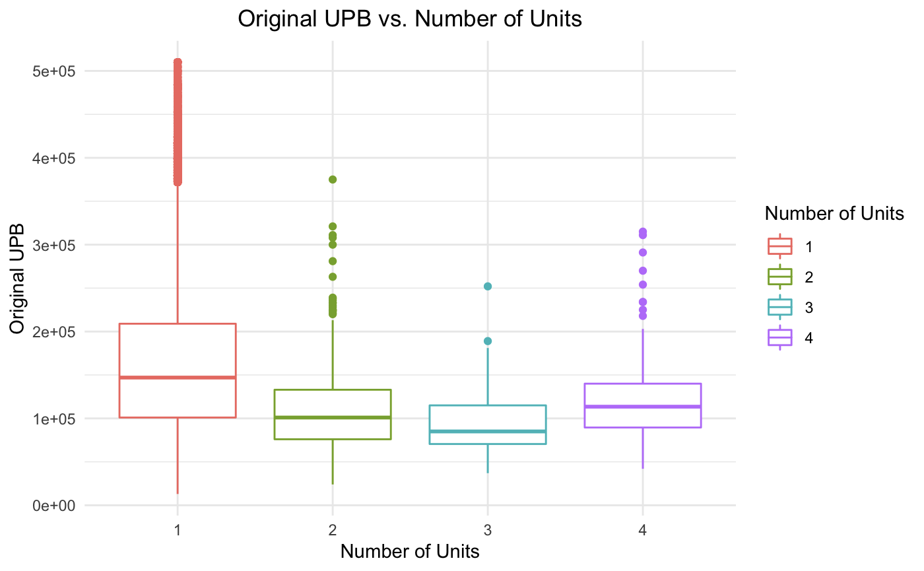
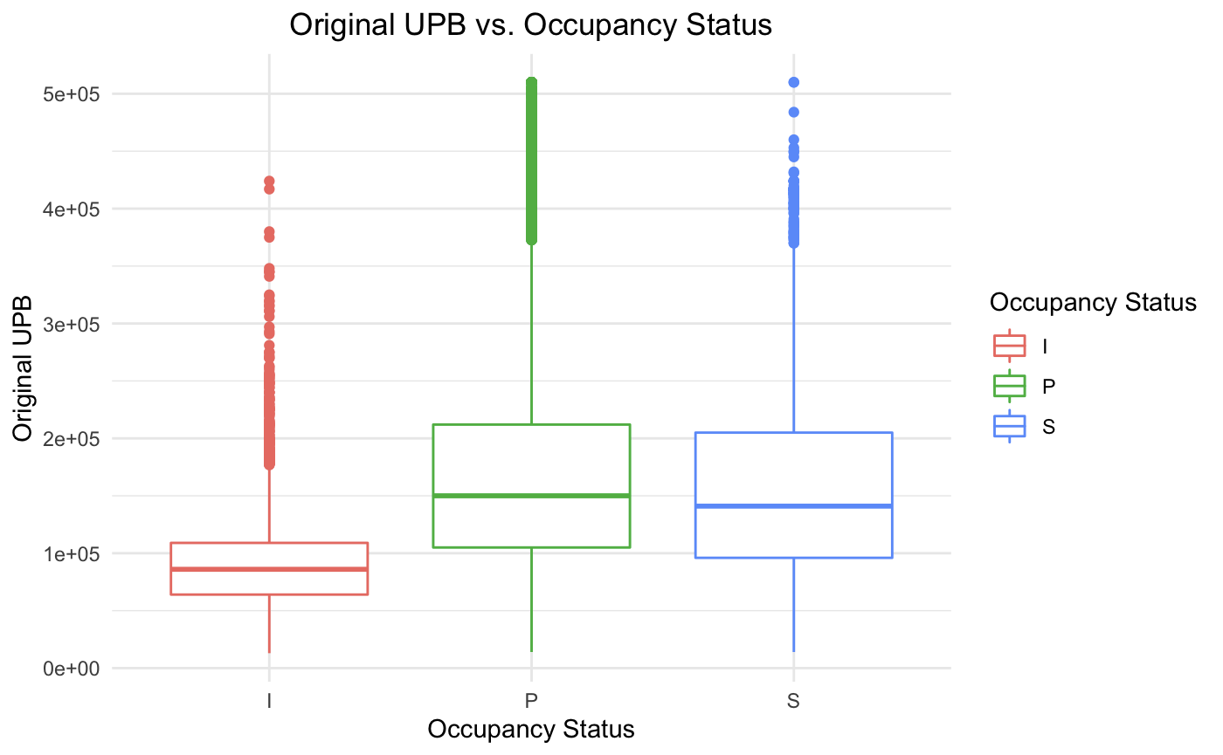
Mortgage Amount
Original UPB by Loan Purpose, Number of Units, and Occupancy Status (Secondary Factors)
1
2
3
$0.5m
$0.4m
$0.3m
$0.2m
$0.1m
0
$0.5m
$0.4m
$0.3m
$0.2m
$0.1m
0
$0.5m
$0.4m
$0.3m
$0.2m
$0.1m
0
Cash-out Refinance
Purchase
Refinance
Refinance
Not specified
Investor
Principal
Second
Findings
Loan Purpose
Purchase money mortgage and refinance mortgage are both associated with a higher dollar amount of loan, while refinance with cash out and refinance - not specified mortgages seem to have relatively lower original UPB.
Number of Units
One unit comprising the related mortgaged property seems to have a relatively higher dollar amount of loan, while the other number of units (two, three, or four) seem to be not significantly different from each other in terms of their corresponding original UPB.
Occupancy Status
Investor property occupancy status seems to have comparatively lower dollar amount of loan, and there is not much difference in the higher dollar amount of loan between principal and second property occupancy status.
1
2
3

Slide 10
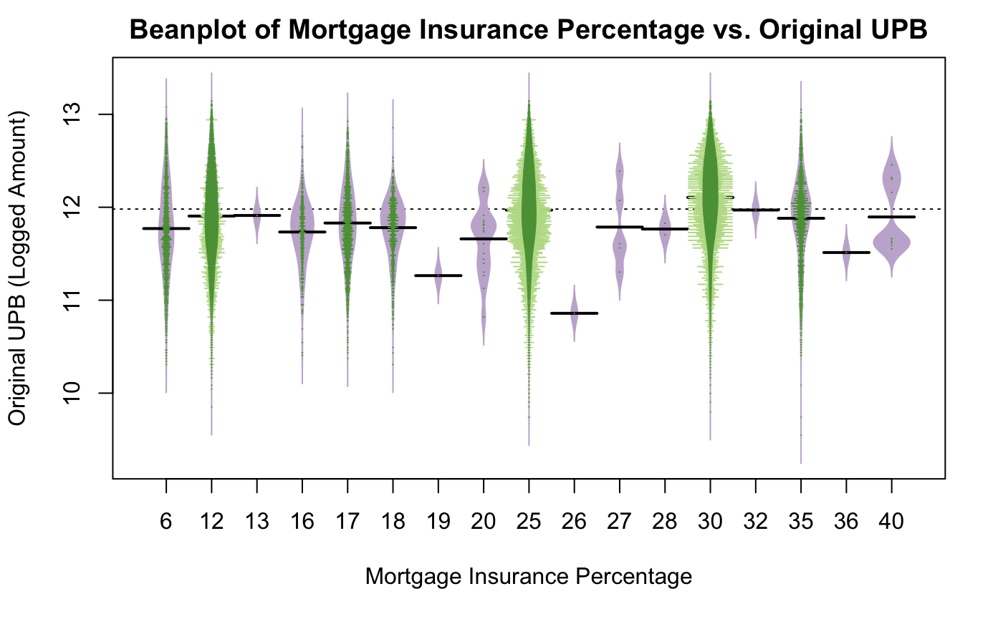
Mortgage Amount
Original Unpaid Balance (UPB) by Mortgage Insurance Percentage (Secondary Factors)
Findings
We looked for a trend to see whether insured mortgages would have a lower UPB
The graph shows the distribution of all types of Mortgage Insurance Percentage. Mortgages requiring mortgage insurance have a lower mean original UPB versus the mean of all mortgages
Mortgage insurance percentages of 19%, 26%, and 36% have comparatively lower median for the original UPB

Slide 11
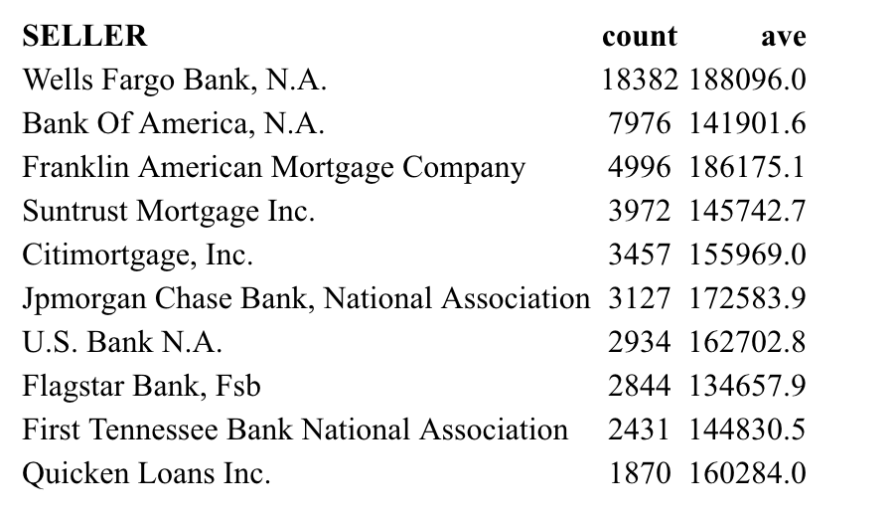
Market Environment
Competitors
SELLER | AVE
Fifth Third Bank | 335000.0
Finance of America Mortgage LLC | 315250.0
J.P Morgan Madison Avenue Securities Trust | 288000.0
PennyMac Loan Services, LLC | 275250.0.
Truist Bank (Formerly SunTrust Bank) | 259339.3
Pmt Credit Risk Transfer Trust | 256142.9
NewRez LLC | 253300.0
Movement Mortgage, LLC | 252000.0
Fairway Independent Mortgage Corporation | 249400.0
Truist Bank (Formerly Suntrust Bank) | 247255.0
SELLER | APPLICATIONS | AVE
Wells Fargo Bank, N.A. | 18382 | 188096.0
Bank of America, N.A. | 7976 | 141901.6
Franklin American Mortgage Company | 4996 | 186175.1
Suntrust Mortgage Inc. | 3972 | 145742.7
Citimortgage, Inc. | 3457 | 155969.0
J.P Morgan Chase Bank, National Association | 3127 | 172583.9
U.S. Bank N.A | 2934 | 162702.8
Flagstar Bank, Fsb | 2844 | 134657.9
First Tennessee bank National Association | 2431 | 144830.5
Quicken Loans Inc. | 1870 | 160284.0
Rank by Average Mortgage Amount
Rank by successful loan applications
The group lists the ten most competitive opponents in two ways. The first table uses the average mortgage loan amounts per application to rank the competitors and uses the successful loan applications to organize the second table.
By comparing the two tables, the group noticed that J.P Morgan Chase exists in both tables, despite being in the different company branches, indicating that J.P Morgan Chase might be the strongest opponent.
Despite the heavy amount of competition from large players, we believe by employing a targeted geographic strategy, we can be a strong competitor in the mortgage market in Nebraska

Slide 12


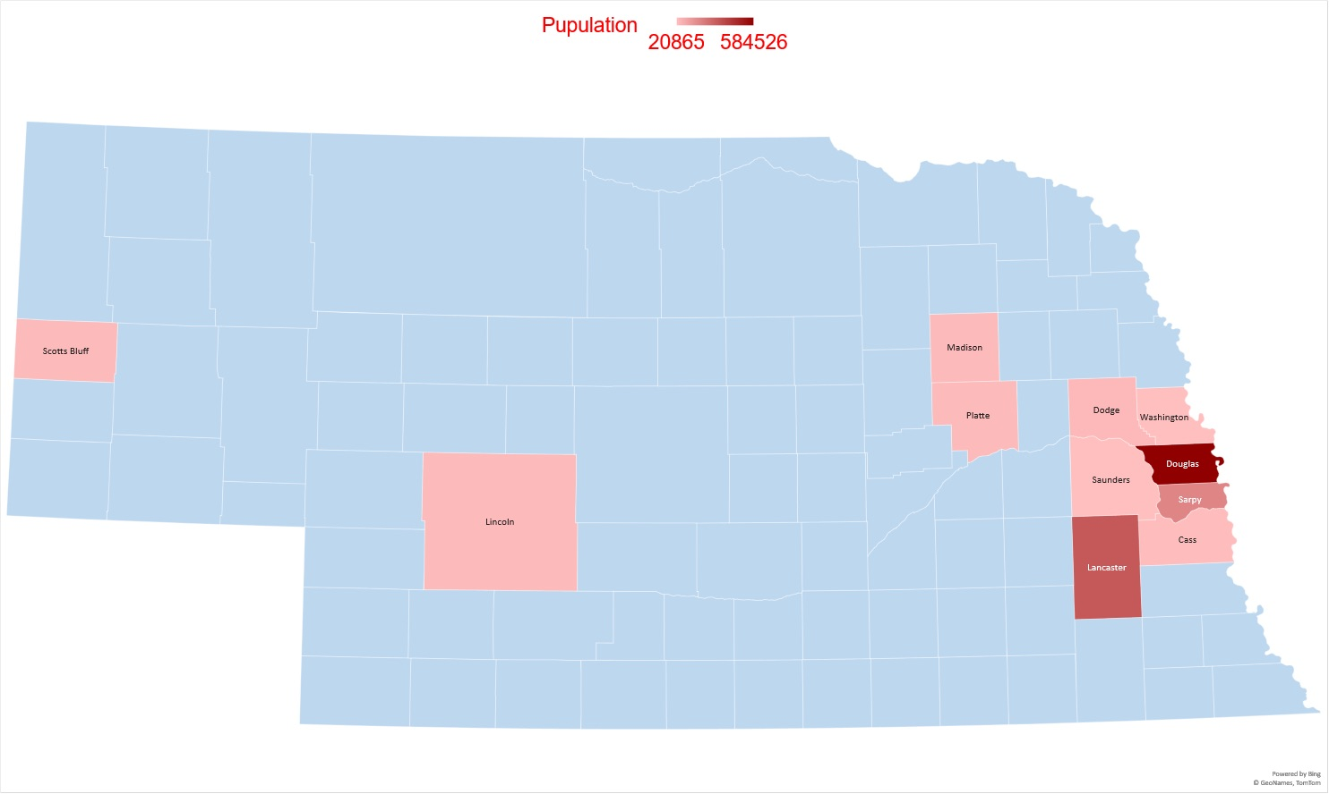
Market Environment
Population Map
Commentary
By analyzing the population distribution in Nebraska state, the group found that most of the people are concentrated[1] in Douglas County (584,526), Lancaster County (322,608), Sarpy County (190,604), Hall County (62,895)
Population in other counties are below 60,000. The population distribution indicates our initial branches should be focused in urban areas, in the cities of Lincoln, and Omaha.
Notes:
[1] Population statistics taken from https://www.nebraska-demographics.com/counties_by_population

Slide 13
Recommendation
Our Target Segments
<79%
<80%
<32
>750
Primary Considerations
Original Loan-to-Value
Original Combined Loan-to-Value
Debt-to-Income
Borrower Credit Score
To limit the number of defaulting (Primary Factors) :
Our ideal market segment should include a criteria based on a borrowers’ original loan-to-value and original combined loan-to-value Our findings showed that the lower the ratio is, the lower the chance it could be a defaulting loan.
Identify borrowers’ debt-to-income ratio and borrower credit score, and whether it was in a delinquent status before. Among all four factors original loan-to-value as it had the the coefficient for minimizing the number of defaults in our model.
Property Types
Number of Units
Loan Purpose
Mortgage Insurance
Occupancy Status
Urban Areas
Secondary Considerations
Planned Urban Dev.
Single Family Homes
Condos
≤2 Units
Refinance
Purchase
No Mortgage Insurance
Principal and Second
Douglas County
Lancaster County
Sarpy County
Hall County
To maximize dollar value of the mortgage (Secondary Factors):
Ideally, anyone who meets our primary considerations will be in our target segment
However, given that the Bank is a new entrant in Nebraska, it would be wise to spend marketing dollars specifically for the below criteria:
We target the three largest property types (Planned urban developments, Single Family Homes, and Condos)
We target the largest market for the Number of Units, ≤2
We target those who are seeking a Purchase and Refinance mortgages
We target those who do not require Mortgage Insurance
We target those who are seeking a mortgage for either their Principal or Second homes
We open branch locations in only Urban areas, where the largest amount of the mortgage market is

Slide 14
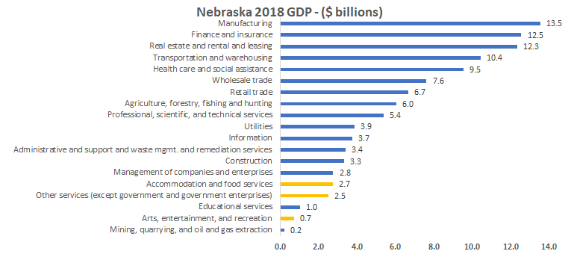
Consideration of Economic Scenarios
An Overview of Different Scenarios
Nebraska Economic Overview
As mentioned in the introduction, Nebraska has been more resilient to unemployment versus the nation, and has historically had lower delinquency rates
Nebraska has an incredibly diverse economy, ranging from Manufacturing to resource extraction
According to IBISWorld[1], Nebraska has the 4th lowest economic exposure to COVID-19 out of 50 states in the United States
K-Shaped Recovery
U-Shaped Recovery
In an event of a K-Shaped Recovery (i.e. some sectors recover, some decline), the highest exposed areas[1] of the economy include Accomodation and Food services, Other services (excl. gov.), and the Arts, entertainment and recreation sectors, which make up 5.4% of the GDP
However, as Nebraska has maintained resilience throughout the COVID-19 Pandemic, we believe that a Nebraska expansion would be greatly beneficial, and would help diversify the mortgage portfolio of Great Lakes Midwest Bank
In an event of a U-Shaped Recovery (i.e. a period of stagnation before recovery), we believe that due to the lower unemployment rate in Nebraska vs. the majority of other states, and the diverse economy, we believe that a Nebraska expansion would still be greatly beneficial to Great Lakes Midwest Bank
While keeping in mind potential interest rate fluctuations, we note that U.S. mortgage terms are usually between 15-30 years long, which would minimize the impact to existing and future mortgage borrowers, and recommend that as long as they meet our segmentation criteria, that they should qualify for a loan
Notes:
[1]: https://www.ibisworld.com/united-states/economic-profiles/nebraska/

Slide 15
Recommendation of Next Steps
Thank you
We need more data on borrowers’ income to analyze the relationship on mortgage amount and income, and to also predict an accurate debt-to-income rate threshold based on the income.
If the dataset can be provided for a longer series of time, we can conduct time series analysis to determine how if the mortgage market is being affected by COVID-19 and make further recommendations to the Bank.
We might require borrowers’ demographic information like age, employment, education and etc. to identify potential factors that lead to a defaulted loan, however we understand the application of these factors may be limited to prevent loan discrimination

Slide 16
APPENDIX
Table of Content
Logistics Regression Model with Mixed Effects
Summary Output
Variable Correlation Matrix
GitHub Repository:
https://github.com/Rachellu7/Datathon

Slide 17
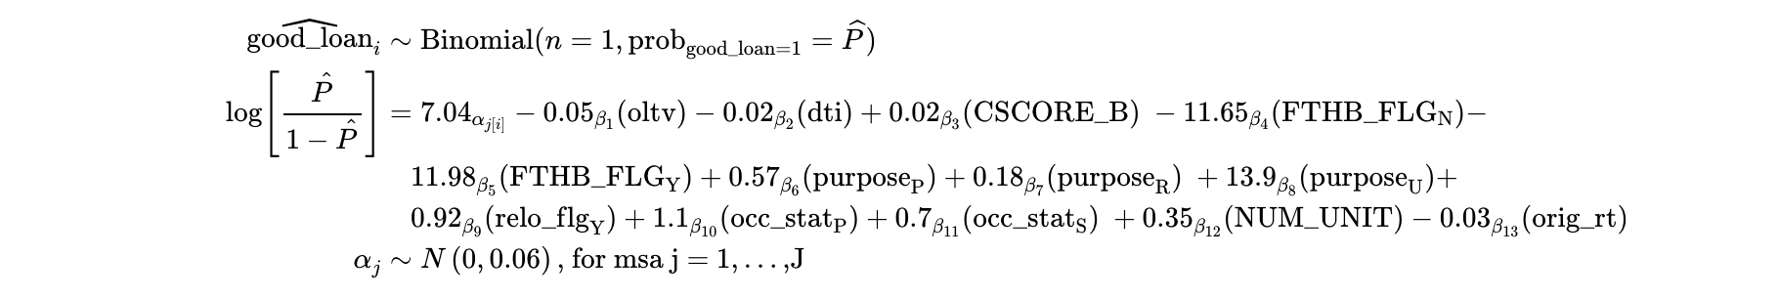
APPENDIX
Logistics Regression Model with Mixed Effects

Slide 18
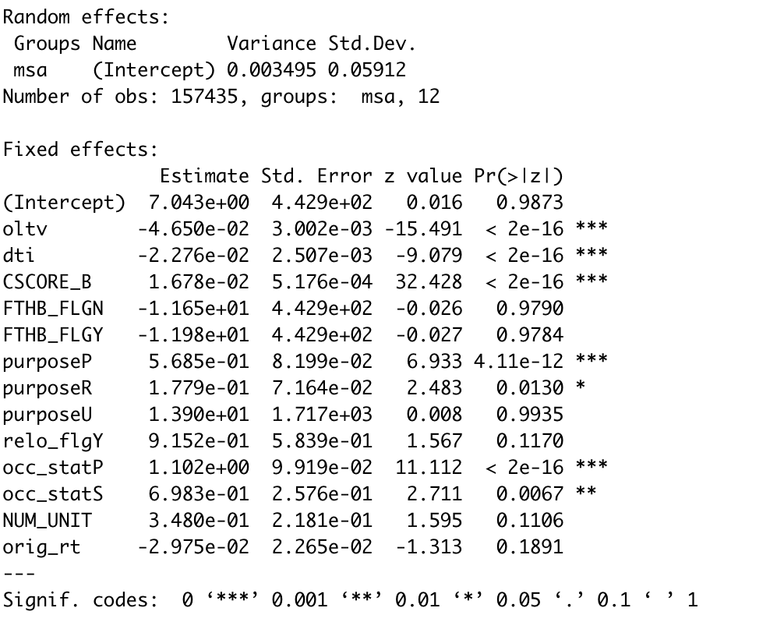
APPENDIX
Summary Output for the Model
The log odds of being successful loan for each percentage increasing in OLTV is 0.047,
then odds=exp(0.047)=1.0481, probability=1.0481/(1+1.0481)=51.17%

Slide 19
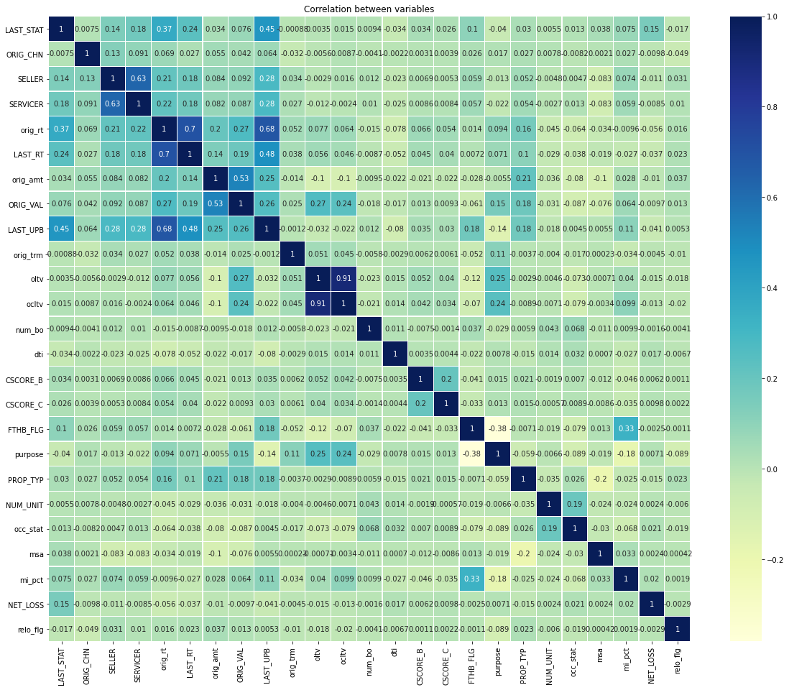
APPENDIX
Variable Correlation Matrix
Commentary
The presented heat map contains the correlations between variables of interest.
Positive correlation between original interest rate (orig_rt) and current actual UPB (LAST_UPB): 0.68.
Positive correlation between last status (LAST_STAT) and current actual UPB (LAST_UPB): 0.47.
Positive correlation between first time home buyers (FTHB_FLG) and mortgage insurance percentage (mi_pct): 0.33.
Positive correlation between current actual UPB (LAST_UPB) and current interest rate ( LAST_RT): 0.48.
Positive correlation between last status (LAST_STAT) and original interest rate (orig_rt): 0.37.
1

